Slide 1
Panorama Android App development
Ren Ye, Dec 2020

Slide 2
Objective
Develop an Android panorama app following the given example app
functional requirement:
live view video
real time panorama stitching progress
able to stitch from left side or right side
start/stop button to start/stop panorama image taking
auto stop when reach the width/angle limit

Slide 3
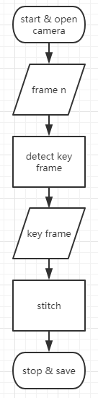
Design
detect key frame by
motion sensor (not available in my device)
OR optical flow (no sweeping angle infomation, hard stop by image width)
stitch
OpenCV stitching API

Slide 4
Available hardware
Huawei media pad S8-701u (Android 4.1 API 16)
Samsung pad A6 (Android 5.0 API 21)
neither have IMU sensor nor compass sensor

Slide 5
Trial 1 (failed)
Using OpenCV Android APK (v3.4.10) + OpenCV manager (v3.4.10)
Optical flow java API working
stitching API not available in java API, have to compile in JNI (C++)

Slide 6
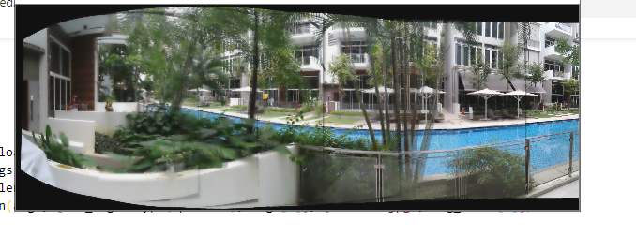
Trial 2: incremental stitching (failed)
OpenCV Android APK (v4.2.0) + JNI + lib_opencv4.so
stitching module working but failed after ~3 key frames

Slide 7
Trial 2 (Optical flow module)
take two nearby frames (e.g. 5 frames apart)
calculate optical flow between the two frames => get flow direction (arctan(dy, dx)) and amplitude (hypot(dx, dy))
direction to determine if the camera is moving to a consistent direction
amplitude to determine if the frames are too near or too far apart
rule of thumb: direction within 2 degree and amplitude around 40 px are considered a key frame

Slide 8
Trial 2 (stitching module)
keyframe_0 and keyframe_1 stitched by cv::stitch() and output as stitched_0
warp: cylindrical, matcher: homography, estimator: homography,
also tried on wave corrector, blender, seam finder, exposure compensator
stitched_0 and keyframe_2 stitched by cv::stitch() and output as stitched_1
stitched_n-1 and keyframe_n stitched and output as stitched_n
However, it failed when n~3 for normal images due to insufficent matching point
and stitched image very blur (due to multiple blending)

Slide 9
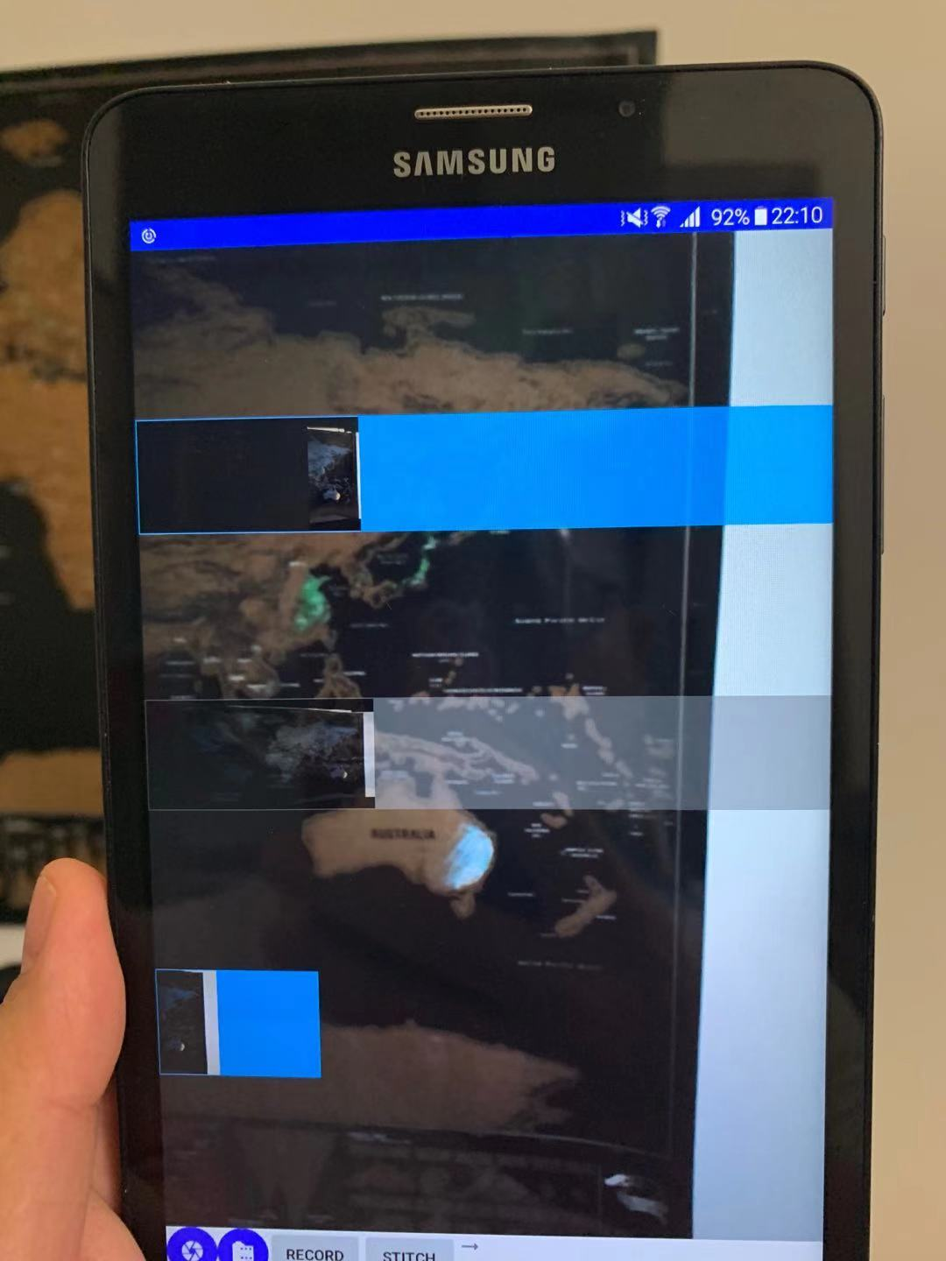
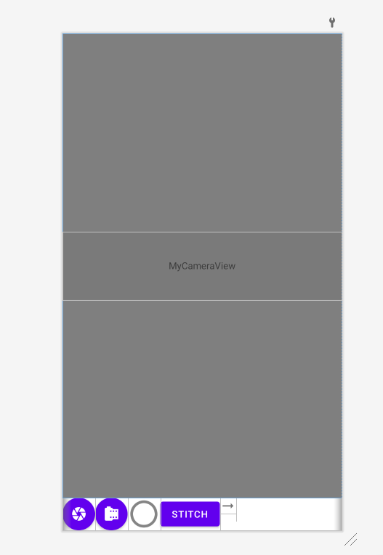
Trial 2 (GUI)
live view
stitched n-1 with mask
stitched n
keyframe n

Slide 10
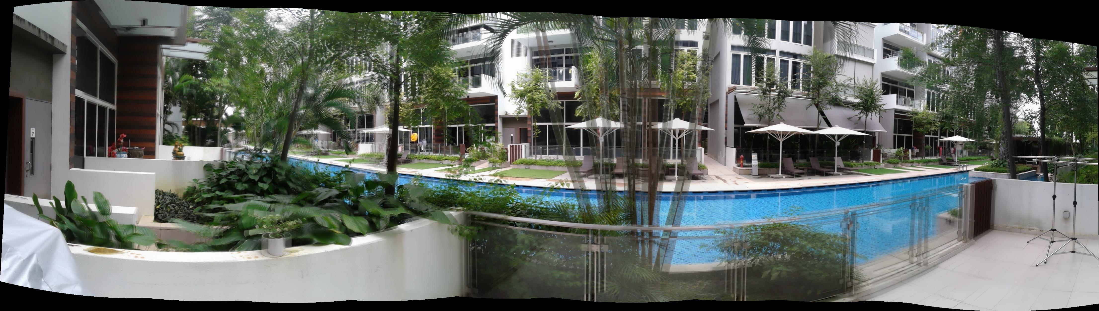
Trial 3 (failed)
rewriting stitching module due to: stitched + key frame will accumulate error and blurry
idea: cache all key frames (kf) and put into stitch module as:
stitch(kf_0, kf_1, kf_2) => display(stitched_2)
stitch(kf_0, kf_1, kf_2, kf_3) => display(stitched_3)
stitch(kf_0, ... kf_n)=> display(stitched_n)
However, it will be too slow when n becomes larger due to pairwise matching in cv::stitch

Slide 11
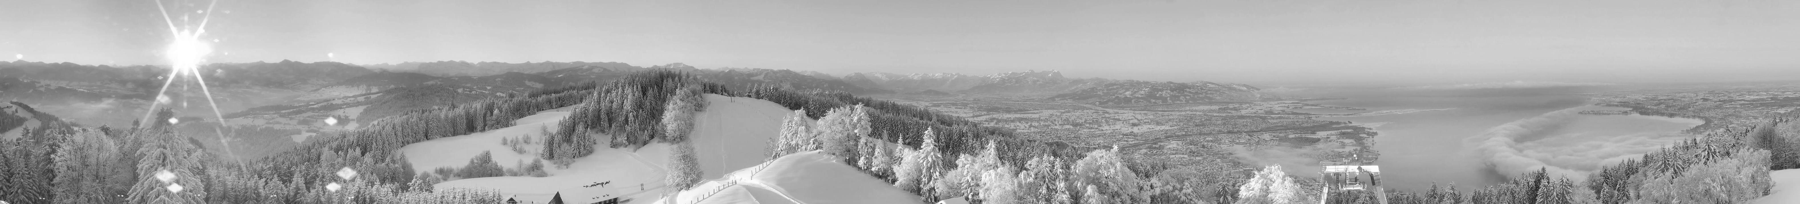
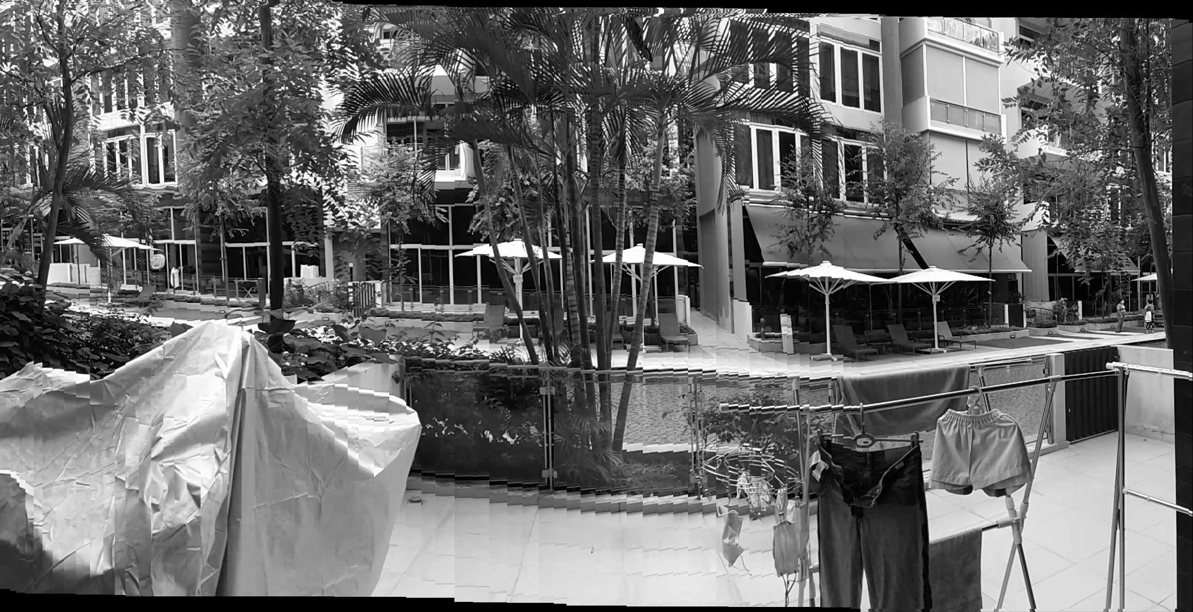
Other trials
use optical flow to estimate translation (workable for mouted, not working for hand held)

Slide 12
Other trials

